Slide 1
AWS TGW BGP with Fortigate
Liu Gang

Slide 2









测试拓扑
AWS Cloud
IGW
Virtual private cloud (sec vpc)
Virtual private cloud (app1 vpc)
Public subnet
attach subnet-1
attach subnet-1
tgw
Private subnet
ebgp
Private subnet
attach subnet-2
attach subnet-2
fgt
app1
web

Slide 3
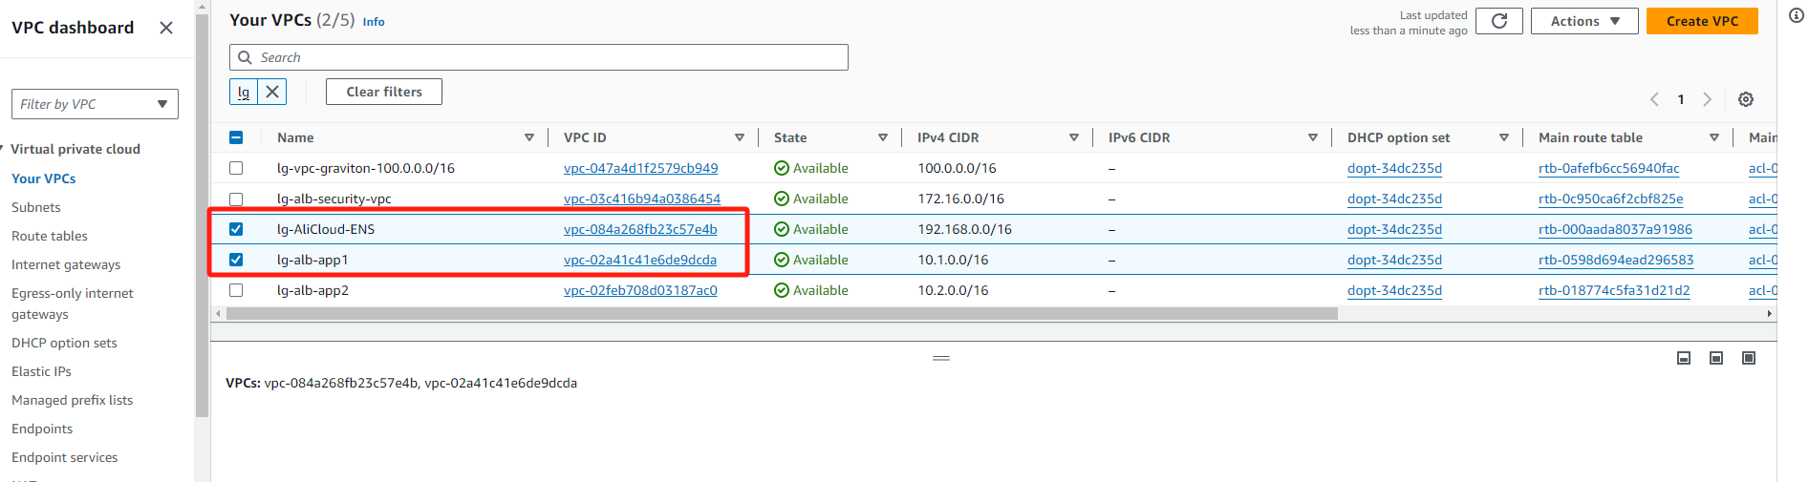
VPC规划

Slide 4
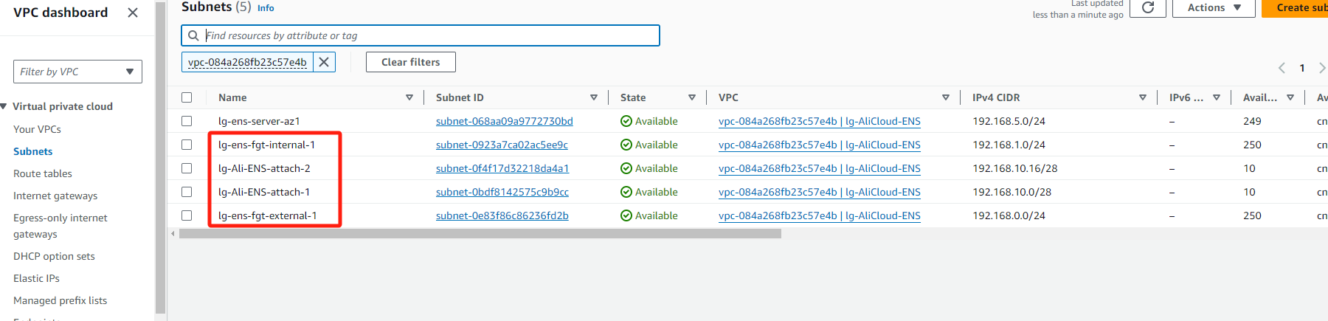
Security vpc subnet规划

Slide 5
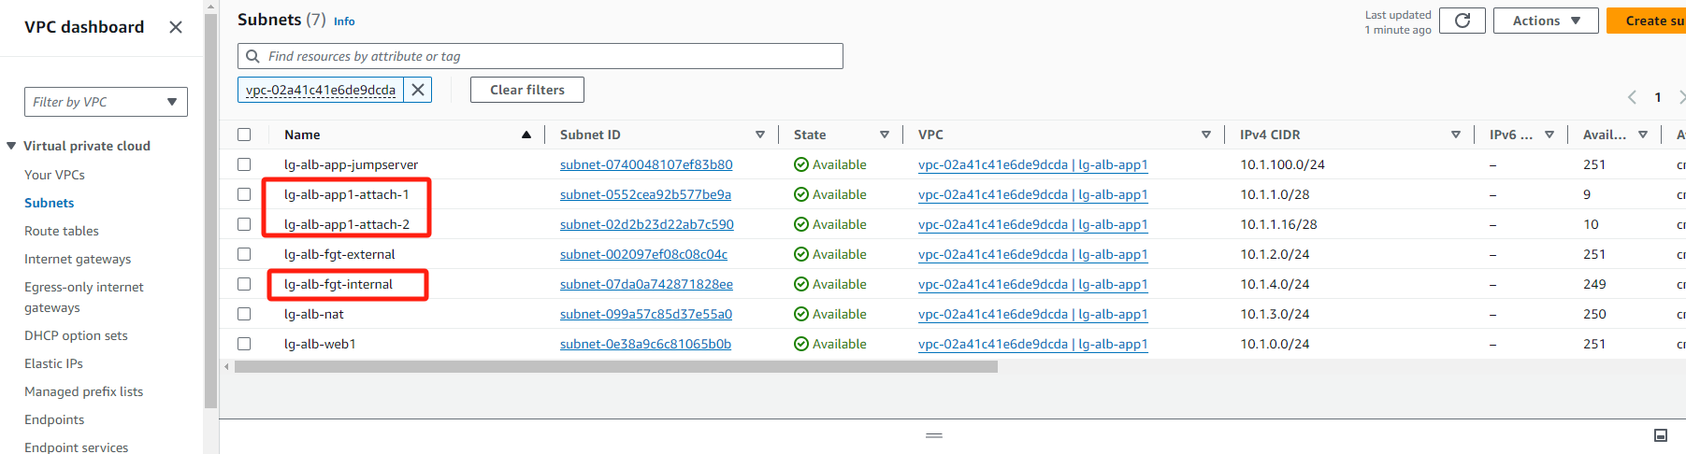
App1 subnet规划

Slide 6
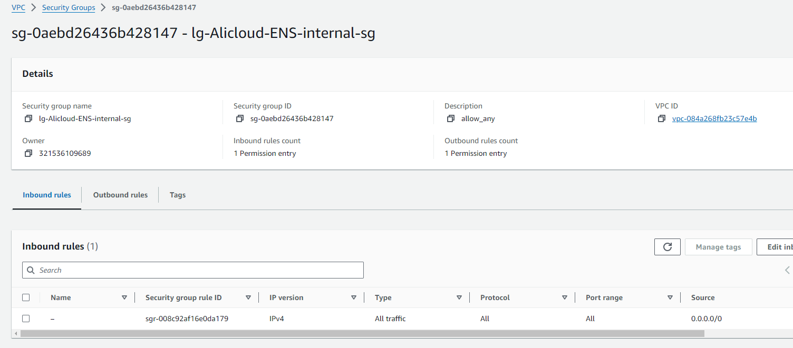
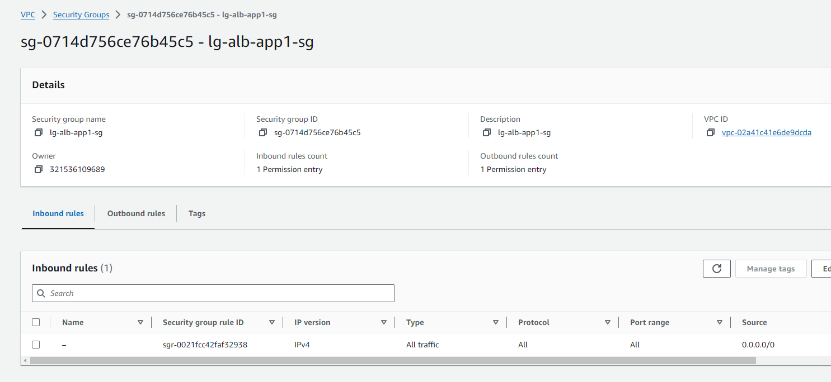
安全组规划
测试阶段防火墙inside接口全开策略，如果严格可以单独开tcp 179和业务访问需求

Slide 7
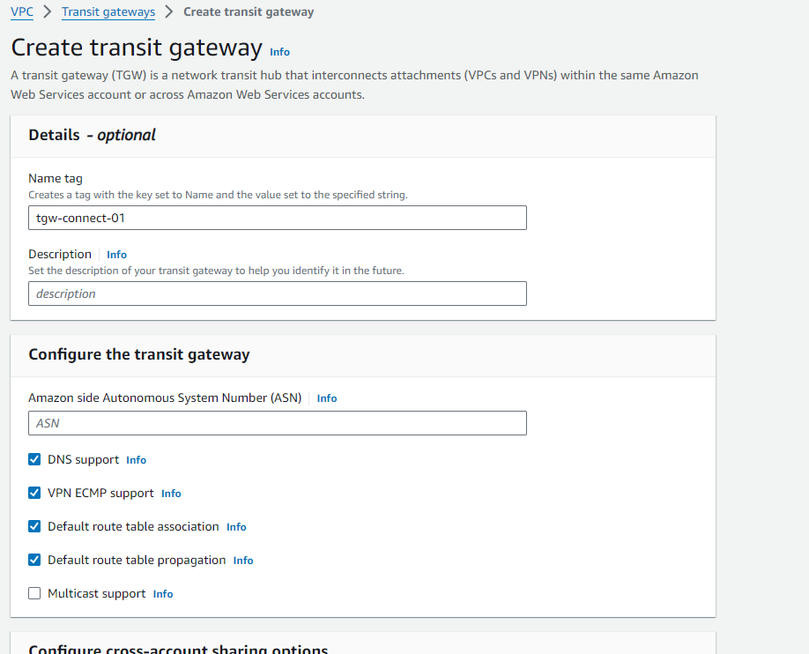
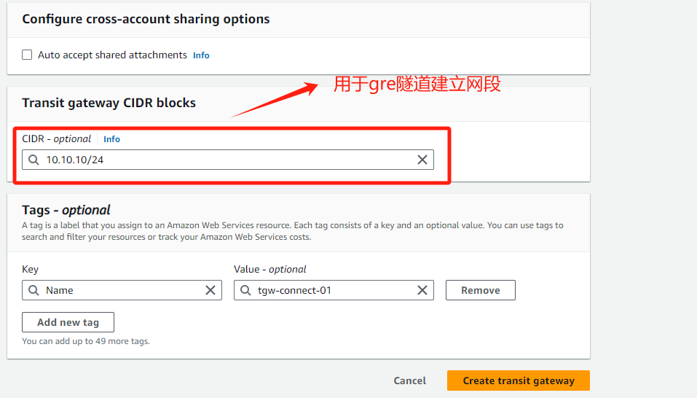
TGW规划-1

Slide 8
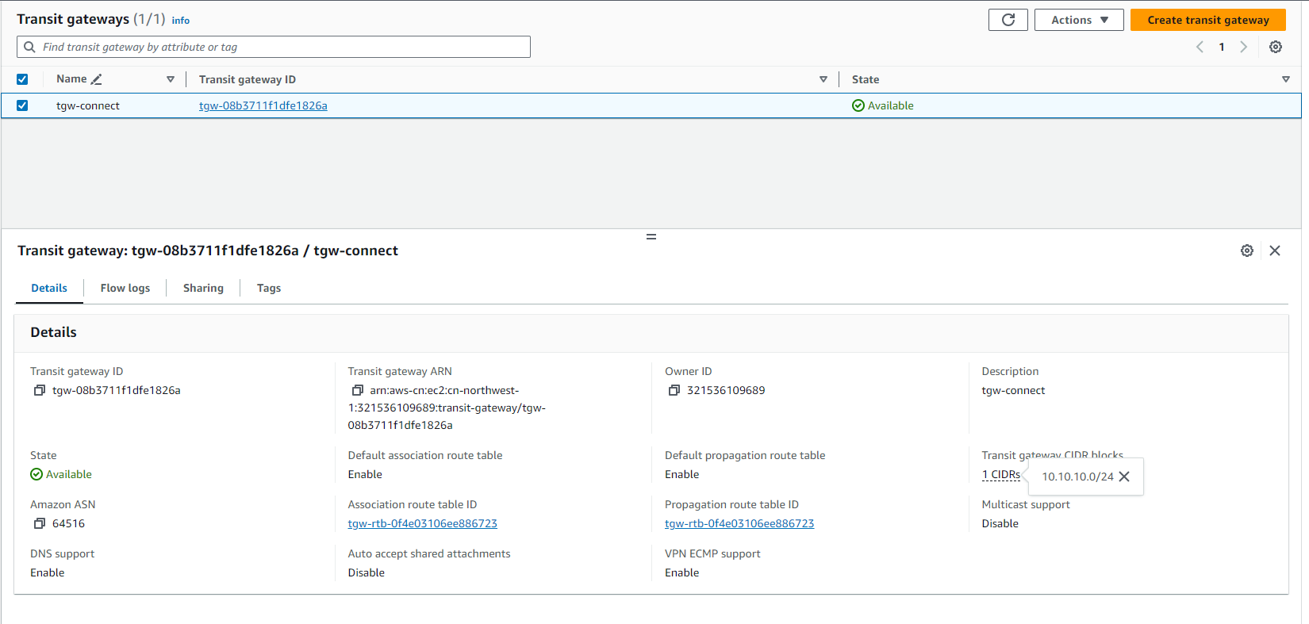
TGW规划-2

Slide 9
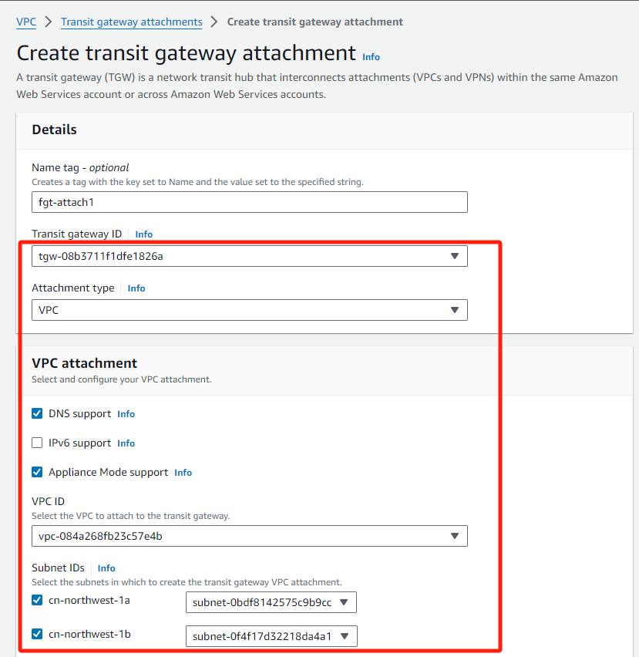
TGW attachment规划-1
创建sec vpc attachment, 指定attachtype subnet 和 attachment type,
另外开启appliance Mode support 确保源进源出

Slide 10
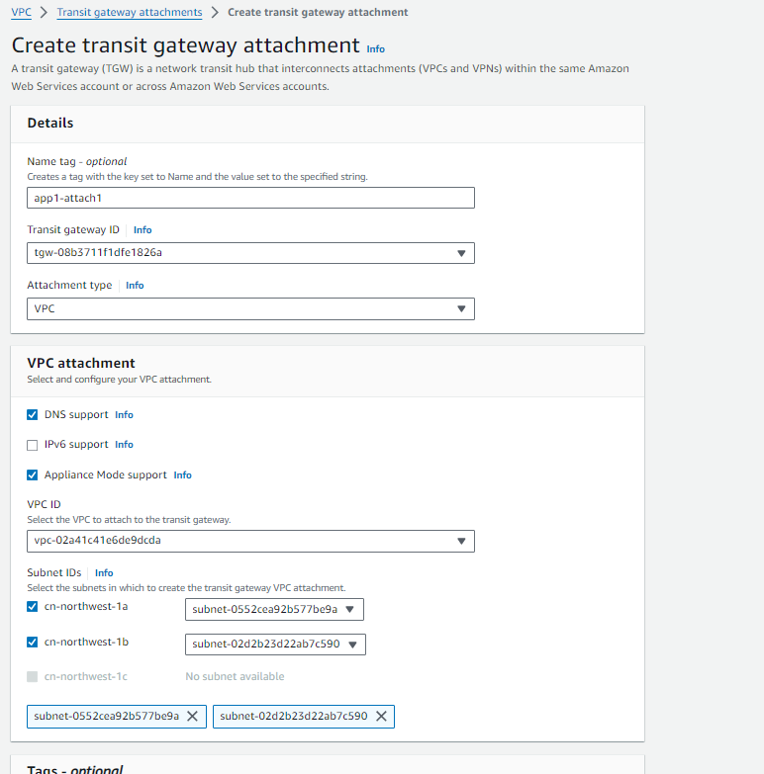
TGW attachment规划-2
创建app1 vpc attachment, 指定attachtype subnet 和 attachment type ,
另外开启appliance Mode support 确保源进源出

Slide 11
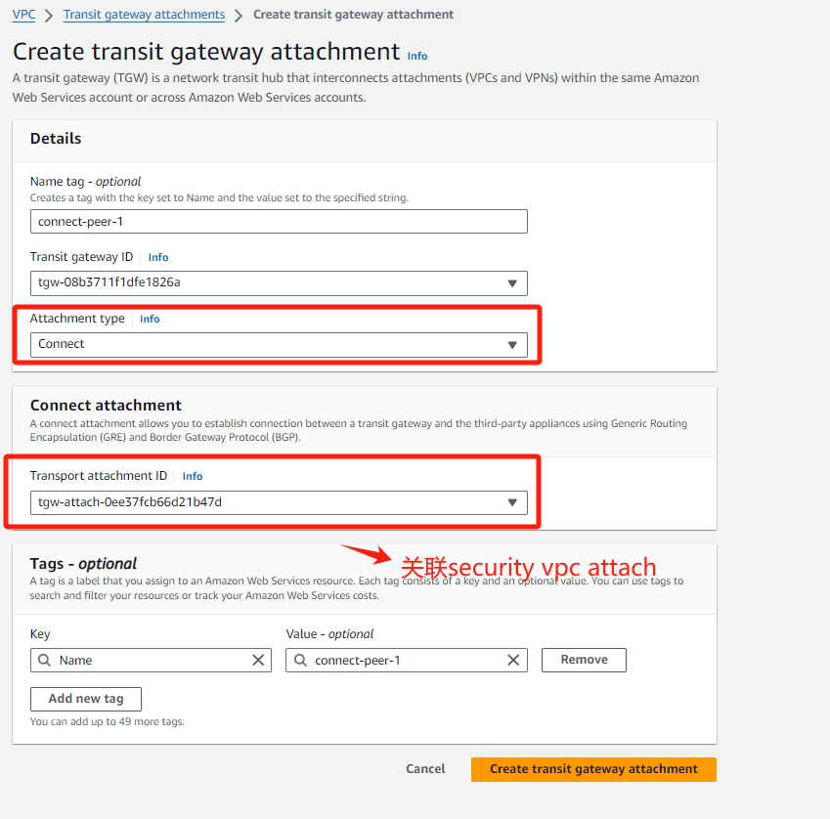
TGW attachment规划-3
创建connect attachment用于和FGT建立BGP over gre, 指定attachtype
attachment type为connect ,关联之前创建sec vpc tgw attachment

Slide 12
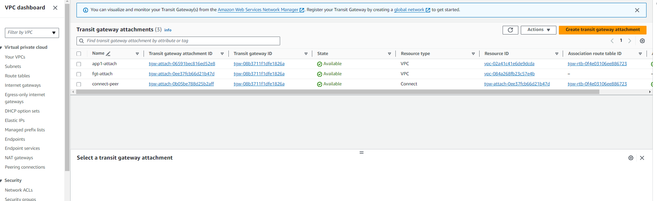
TGW attachment规划-4

Slide 13
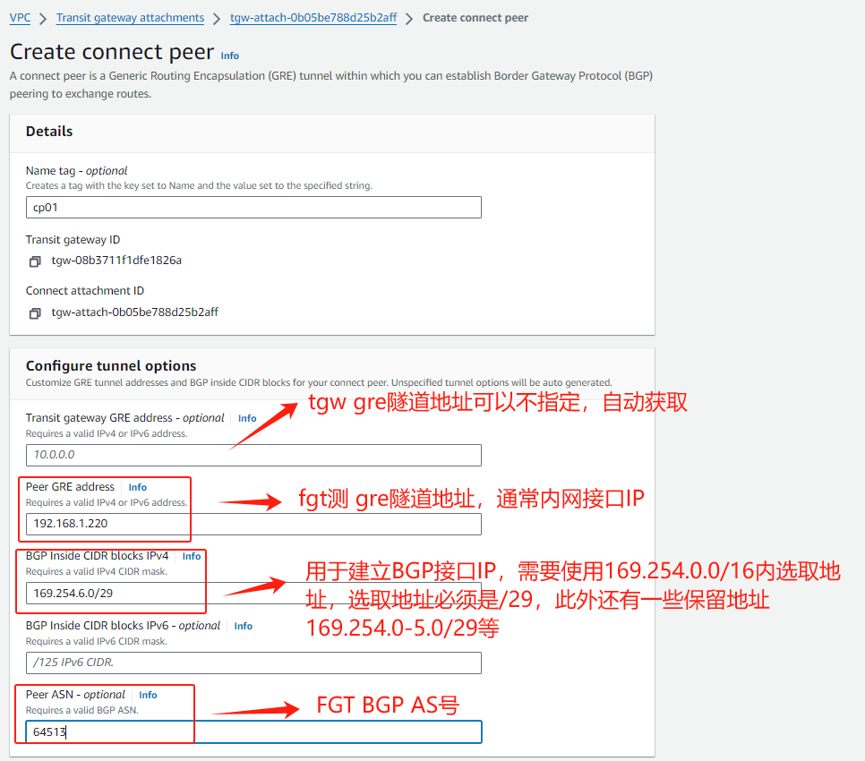
TGW attachment规划-5
Notes:
https://aws.amazon.com/cn/blogs/china/transit-gateway-connect-connection-type-integrates-fortigate-security-service/
https://docs.aws.amazon.com/vpc/latest/tgw/tgw-connect.html

Slide 14
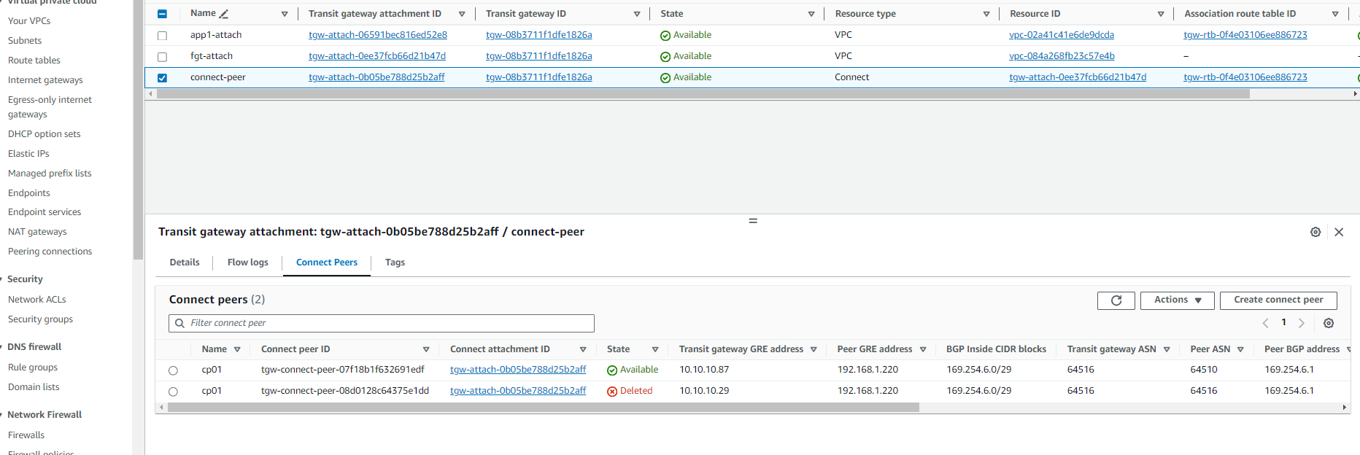
TGW attachment规划-6

Slide 15
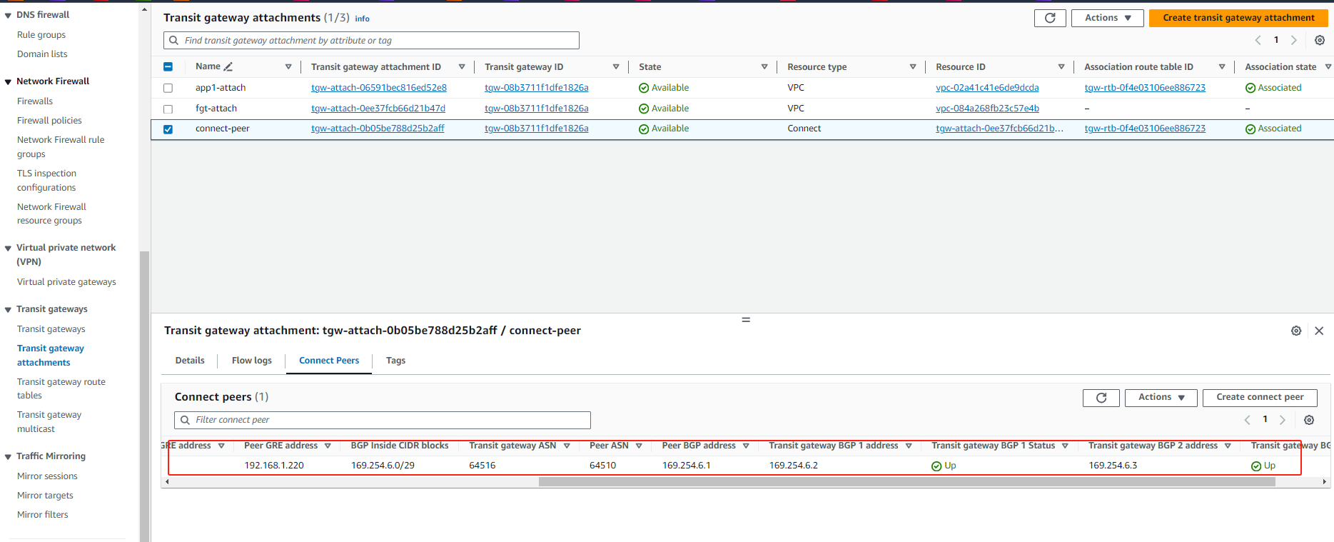
TGW attachment规划-7
GRE和BGP邻居建立OK的状态

Slide 16
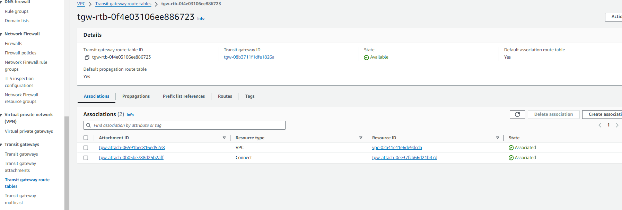
TGW RTB规划-1
默认路由删除了sec vpc attachment 的association 信息，因为防火墙通过BGP和TGW建立路由关系，TGW路由
表只需要app1 vpc 和 connect

Slide 17
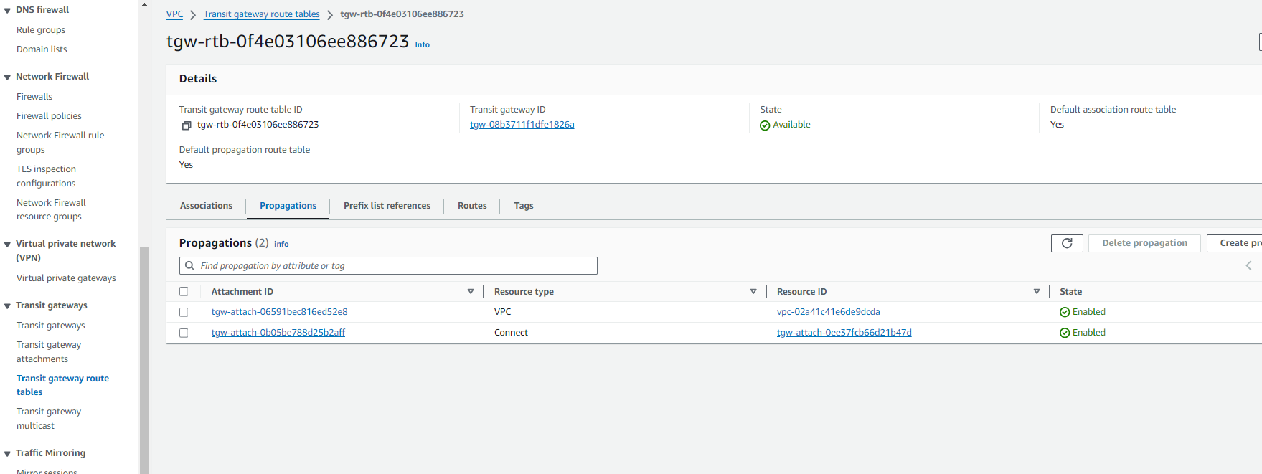
TGW RTB规划-2
默认路由删除了sec vpc attachment 路由propagations 信息，因为sec vpc 路由通过BGP进行通告

Slide 18
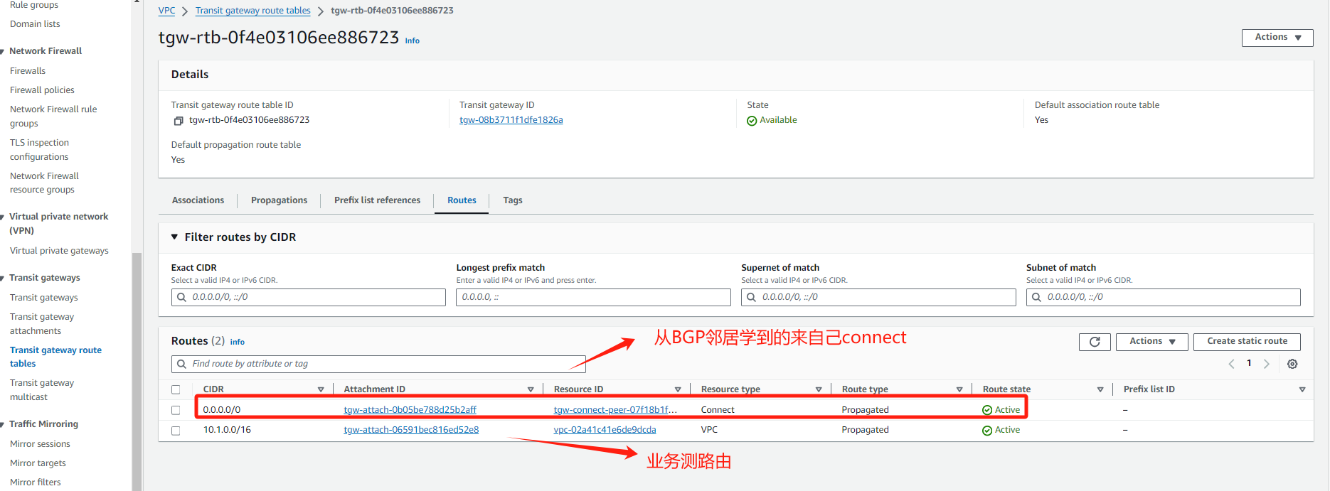
TGW RTB规划-3

Slide 19
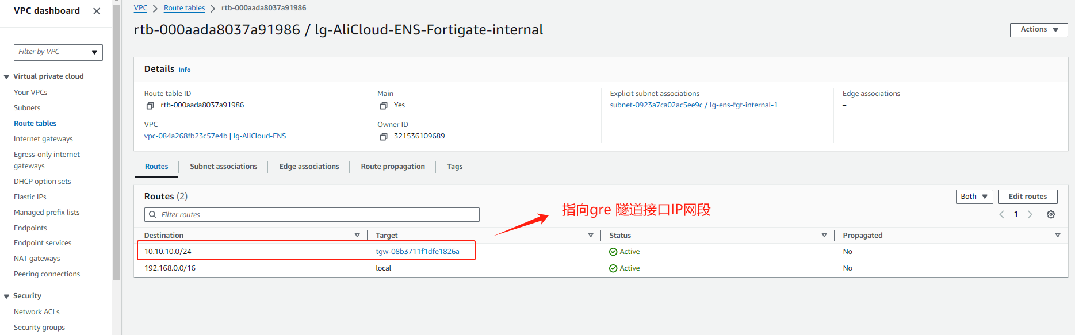
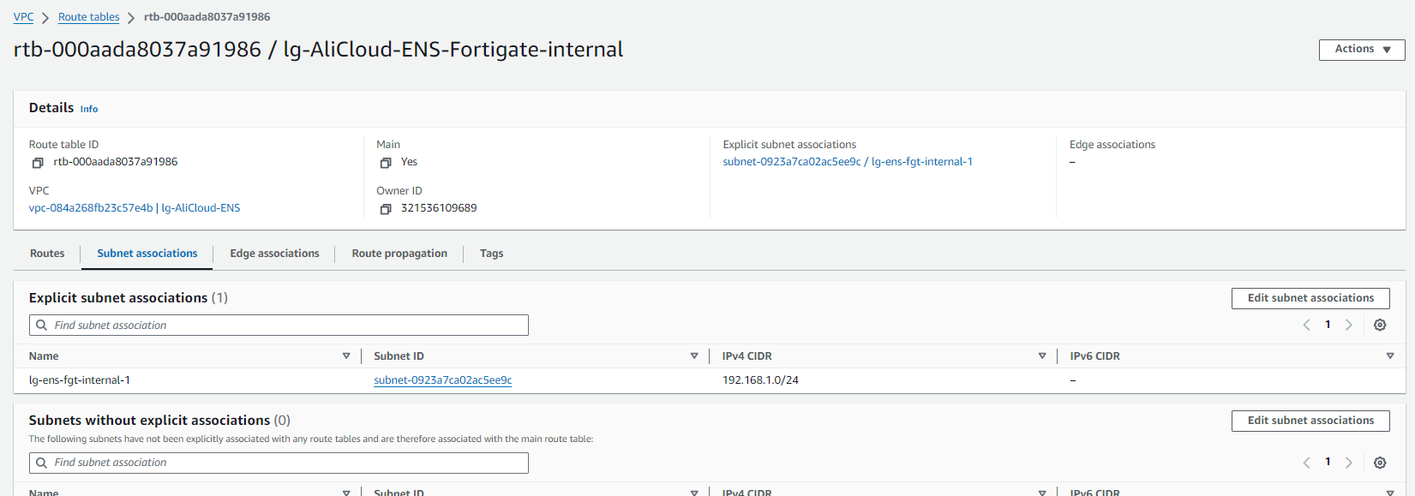
SEC VPC FGT RTB规划

Slide 20
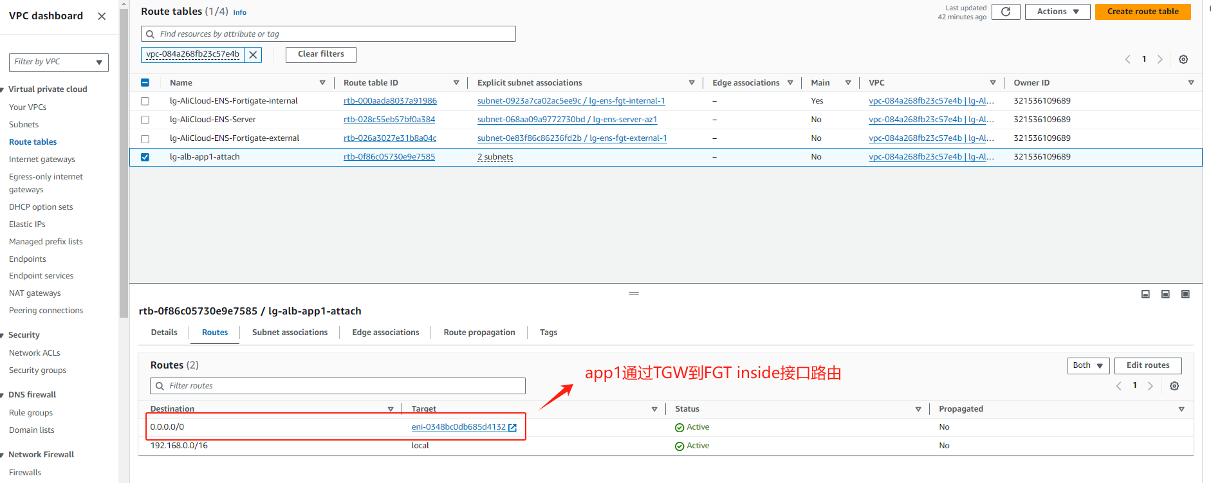
SEC VPC attachment RTB规划

Slide 21
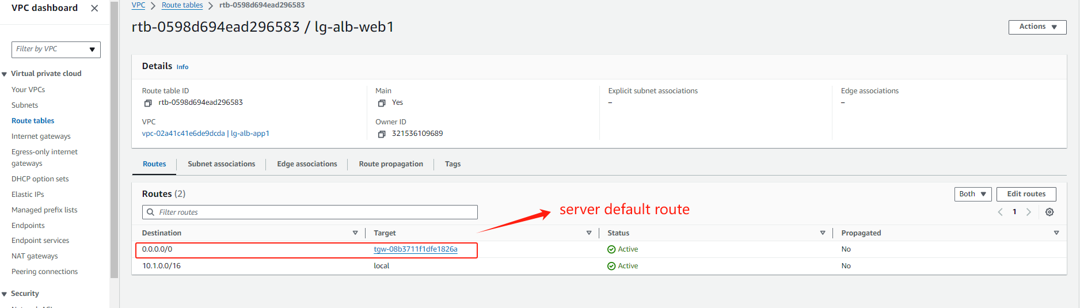
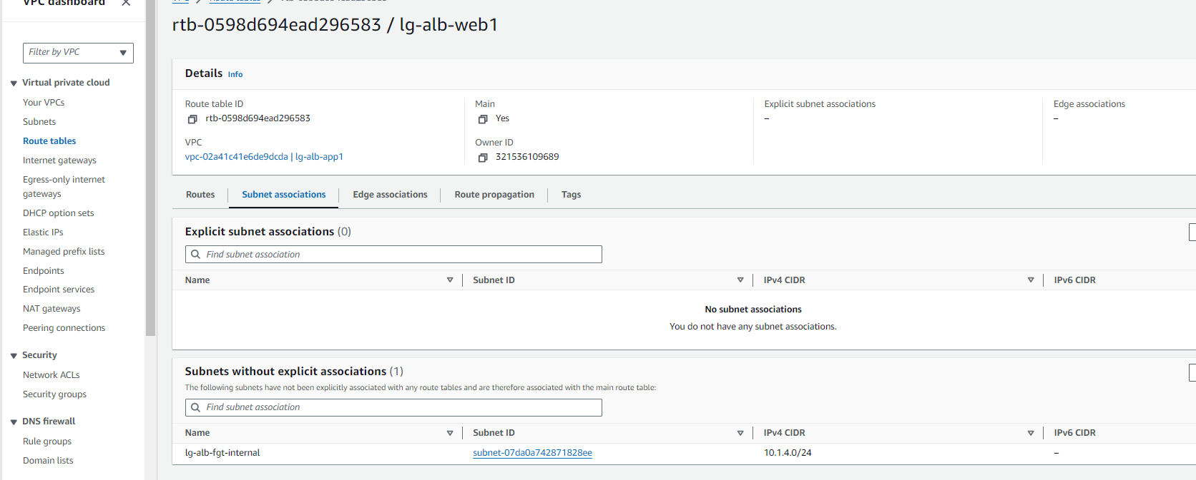
App1 RTB规划

Slide 22
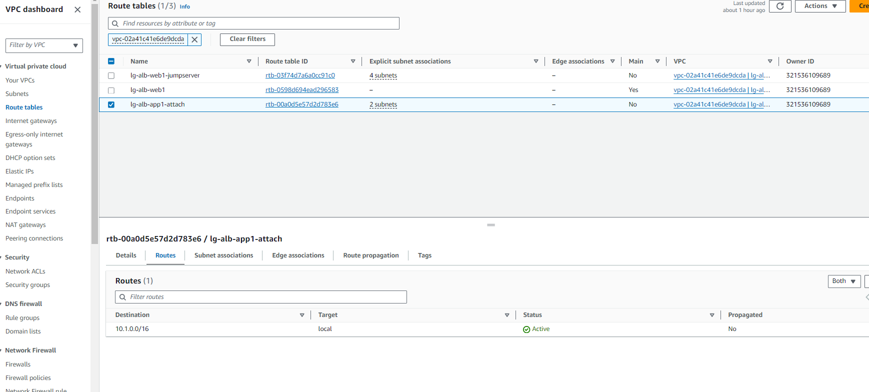
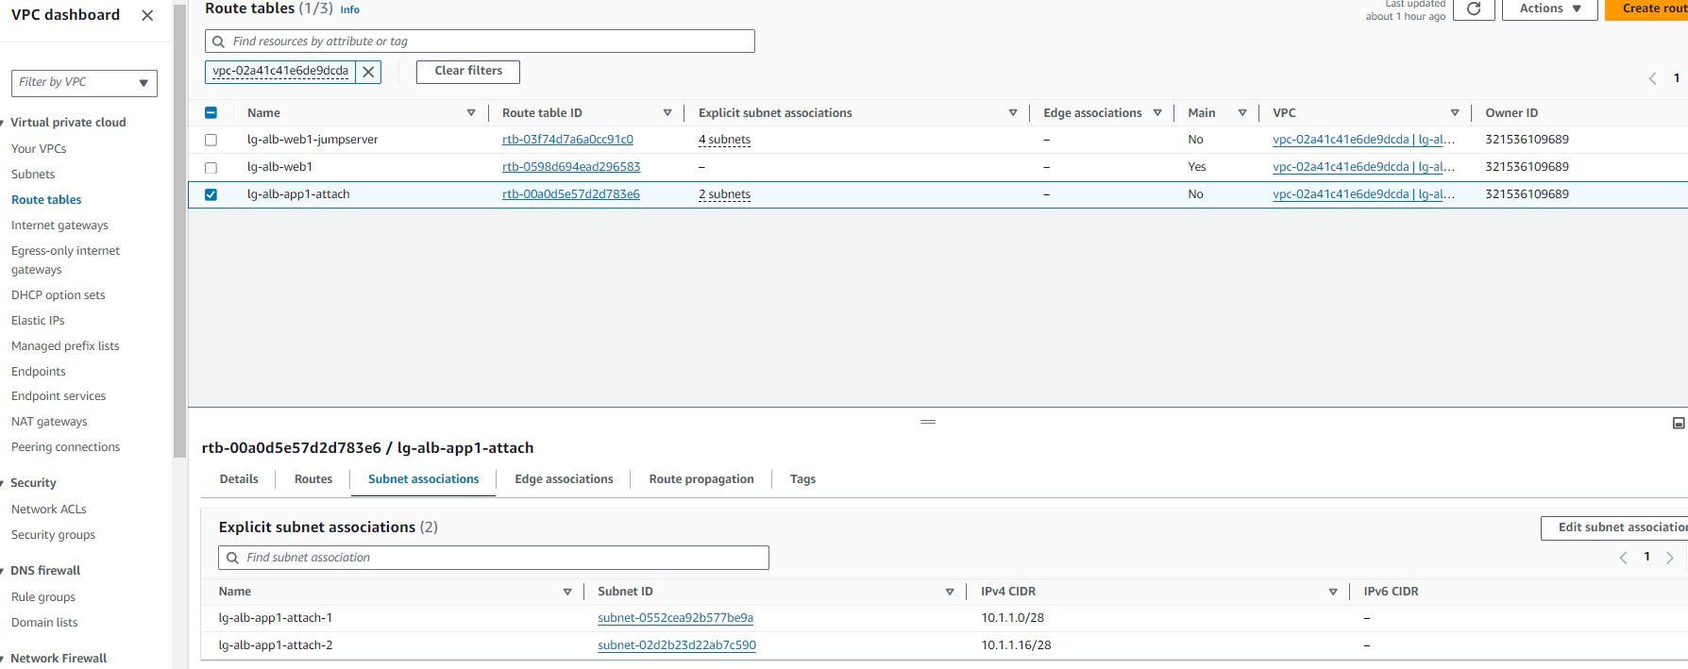
App1 attachment RTB规划

Slide 23
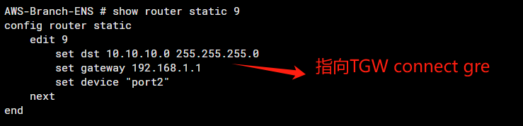
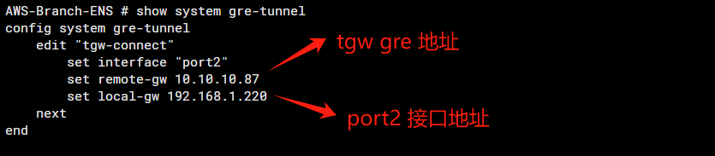
FGT 配置-1
TGW GRE 接口地址在tgw attachment connect 上获取相应的配置信息

Slide 24
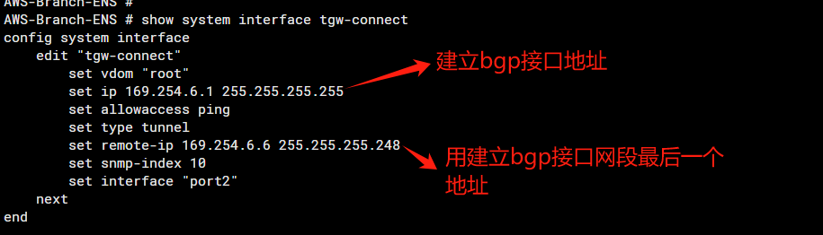
FGT 配置-2
TGW BGP 接口地址在tgw attachment connect 上获取相应的配置信息

Slide 25
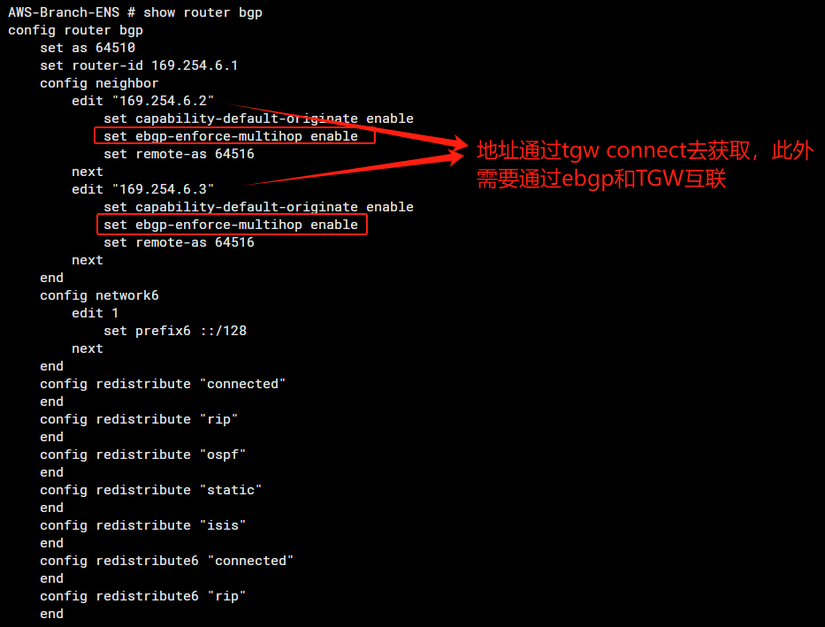
FGT 配置-3

Slide 26
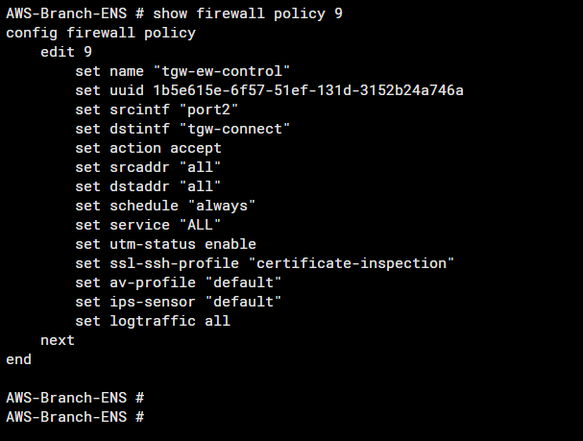
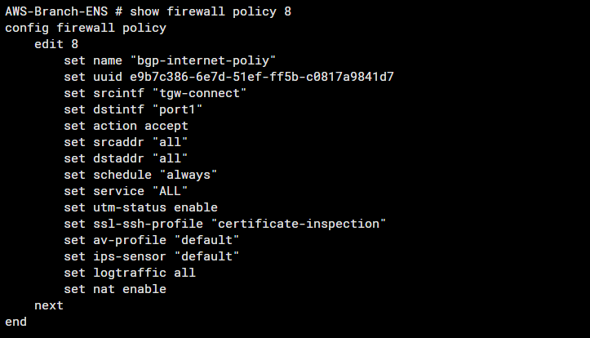
FGT 配置-4
App1 VPC业务上网和东西向访问策略

Slide 27
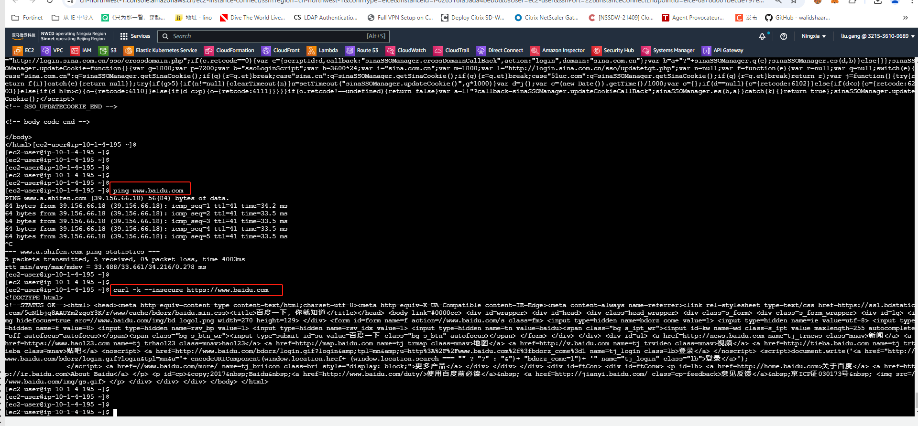
北向业务测试-1
测试server源IP 10.1.4.195

Slide 28
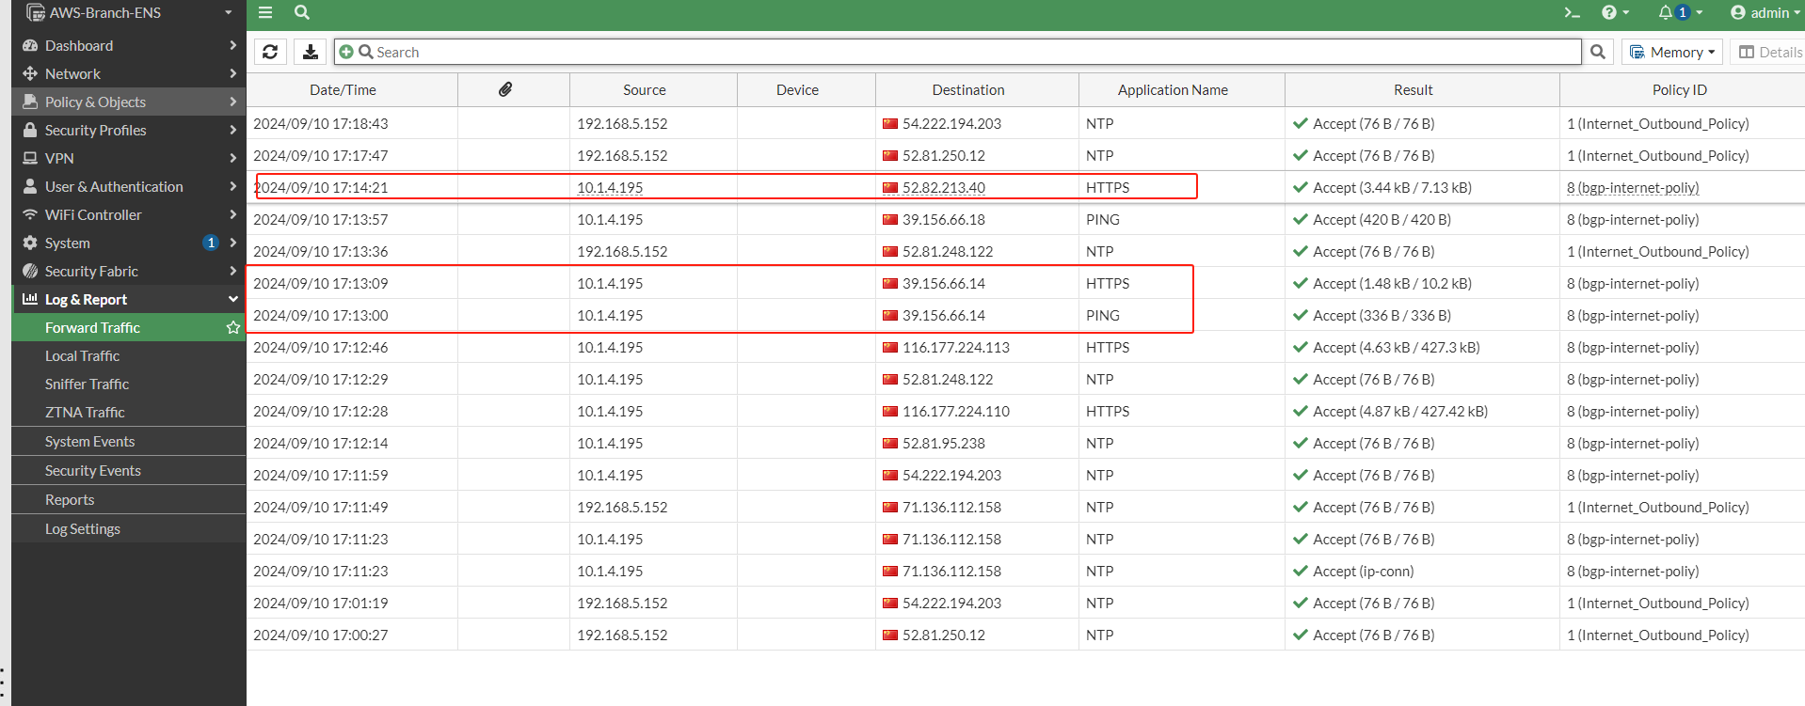
北向业务测试-2

Slide 29
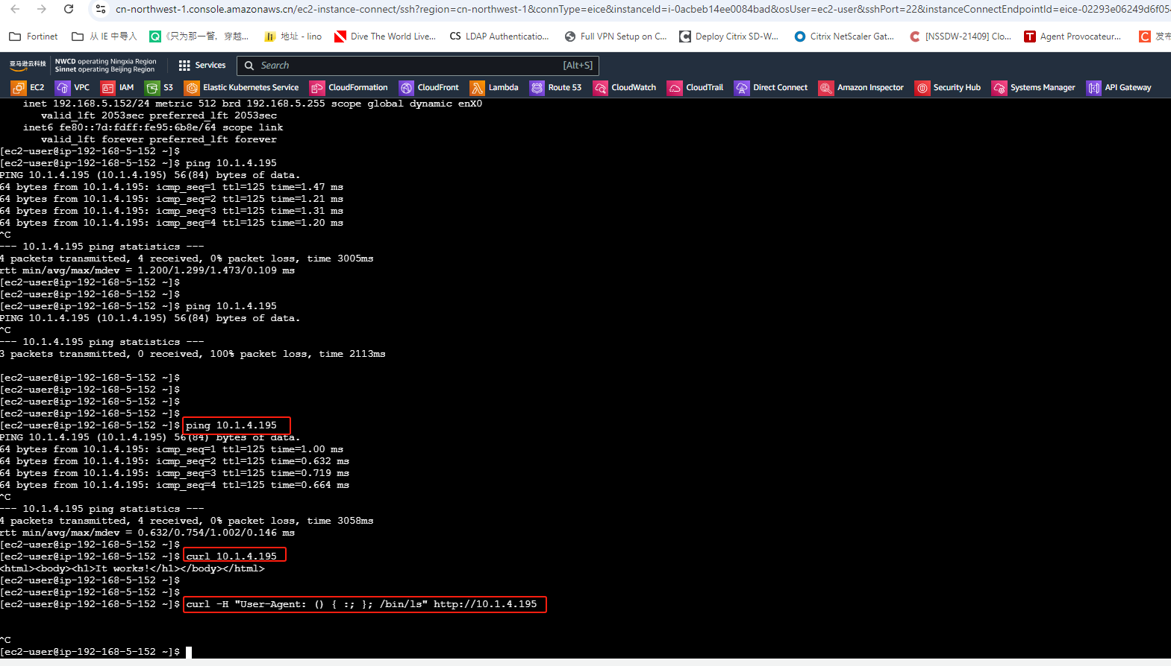
东西向业务测试-1
测试sec vpc server源IP 192.168.5.152 访问 app1 vpc 10.1.4.195

Slide 30
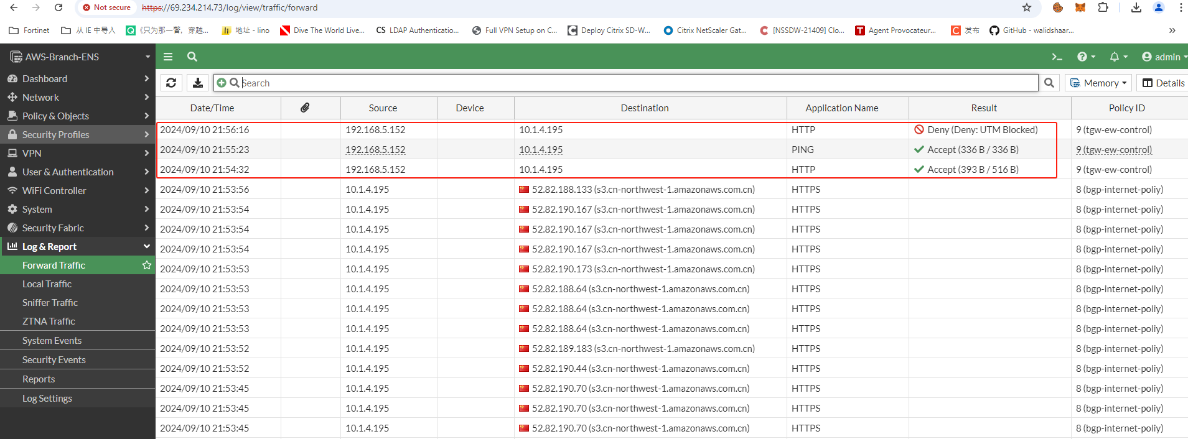
东西向业务测试-2

